Slide 1

Team Name : Cyber Tyrant
Problem Statement : Crafting a lifeline in AI: How do we engineer a humanoid robot that not only bridges the gap to mental health support with empathy and innovation but also revolutionizes learning through a hyper-smart education system, turning the tide against the crisis of suicide with technology that cares and educates.

Slide 2

Brief Idea :
In this project, we are creating a Humanoid Robot named as Companion AI that would not only serve as your personal assistant and helper but also provide emotional support and educational guidance.
We are using Advanced Natural Language Processing(NLP) algorithms that would enable the robot to engage in meaningful conversations, actively listening to and empathizing with individuals experiencing mental health challenges.
Through Deep Learning Algorithms(DL), it could analyze speech patterns, facial expressions, and other biometric data to assess the emotional state of individuals and tailor its responses accordingly.
Alongside its role in mental health support, our robotic assistant serves as an Educational mentor, offering valuable insights, lessons, and knowledge according to user's preference to enhance the individual's personal growth and development.

Slide 3
Opportunity :
Despite the proliferation of interactive assistants in today's world of artificial intelligence, there remains a significant void in addressing critical issues like suicide prevention and educational guidance.
Existing AI assistants fail to provide a holistic approach, with none effectively integrating both suicide prevention and educational support functionalities.
We will utilize advanced natural language processing (NLP) and deep learning techniques to develop a model capable of understanding and addressing human emotions through conversations and facial expressions. This capability will aid in changing or brightening individuals' moods effectively.
Furthermore, the model will serve as an educational mentor, leveraging its understanding of human emotions to provide tailored guidance and support in various educational contexts.

Slide 4
List of features offered by the solution :
Suicide Prevention: By actively monitoring individuals' mental health indicators, the humanoid robot could help identify warning signs of suicidal ideation and intervene proactively. Through compassionate dialogue and targeted interventions, it could provide support, connect individuals with professional resources, and collaborate with caregivers and mental health professionals to ensure timely intervention and support.
Empathetic Design: our humanoid robot will be designed with a focus on empathy, mimicking human facial expressions, body language, and tone of voice to establish rapport with individuals in distress.
Mental Health Support: The robot would serve as a readily accessible mental health companion, providing non-judgmental support, guidance, and encouragement to those in need.
Hyper-Smart Education System: Leveraging AI and machine learning technologies, the humanoid robot could personalize learning experiences for students, catering to their individual needs, strengths, and learning styles. It could adapt curriculum content in real-time, presenting information in engaging formats, stimulating critical thinking, creativity, and problem-solving skills.

Slide 5
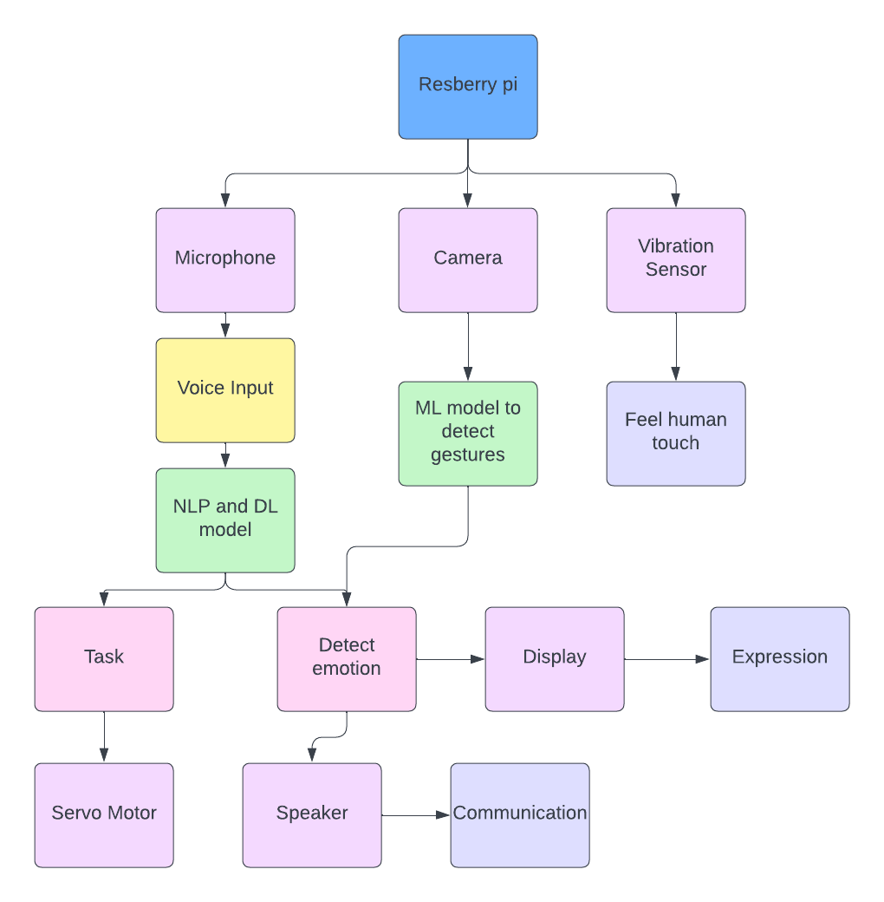
Process Flow Diagram/Usecase Diagram:

Slide 6
Technology used :
Duet AI: It is used to assist in creating personalized learning materials and adapting them to individual student needs
Generative AI Studio: This platform is used to connect the language model to external educational resources and databases. This would allow the AI system to dynamically access and present relevant information in response to student queries, creating a more comprehensive and up-to-date learning environment.
Model Garden: It is used to provide pretrained model and we'll tune it for building the project.
Google Cloud Speech-to-Text: It provides different models optimized for specific types of audio, like video or phone calls.

Slide 7
Estimated cost of/after implementing the solution :
Raspberry Pi (Raspberry Pi 4 Model B): Approximate cost: $35-$75.
Microphone: Approximate cost: $20-$50.
Display: Approximate cost: $30-$70.
Speaker: Approximate cost: $10-$50.
Servo Motors: Approximate cost: $10-$40.
Vibration Sensor: Approximate cost: $10.
Additional Materials for the Body: Approximate cost: $50.

Slide 8


